Slide 1





Agricultural Plastics Recycling
North Carolina
NC Nurserymen & Landscape Association
NC Dept Agriculture and Consumer Services
NC Division of Environmental Assistance and Customer Service
Waste Reduction Partners
NC Tobacco Trust Fund Commission

Slide 2


North Carolina agricultural plastics recycling program
First Step: Work as a team
1. Team Effort
Dept. of Ag, NCNLA, DEACS, WRP
7. Tackle more difficult plastics
2. Learn
Talk with growers & recyclers
6. Outreach
Flyers, Write articles, Rack cards, Website, Facebook.
3. Tackle low hanging fruit
Large acreage grower near a recycler
5. Consolidation Sites
Growers, County Waste Facilities. Farmers Markets
4. Funding
SWMTF
NC Tobacco Trust Fund Commission

Slide 3
Learn from growers & recyclers to find a solution that works for both
1. Team Effort
Dept. of Ag, NCNLA, DEACS, WRP
7. Tackle more difficult plastics
2. Learn
Talk with growers & recyclers
6. Outreach
Flyers, Write articles, Rack cards, Website, Facebook.
3. Tackle low hanging fruit
Large acreage grower near a recycler
5. Consolidation Sites
Growers, County Waste Facilities. Farmers Markets
4. Funding
SWMTF
NC Tobacco Trust Fund Commission

Slide 4
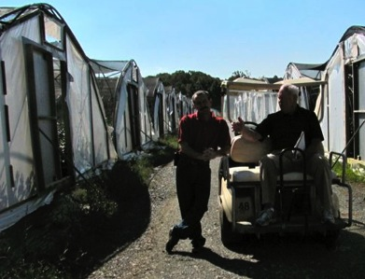
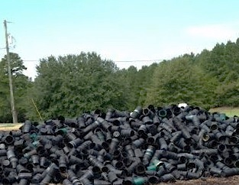
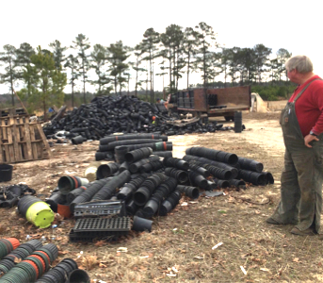
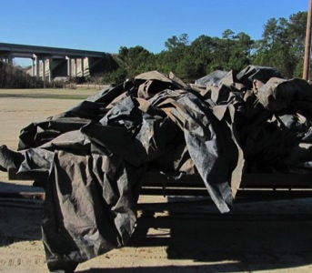
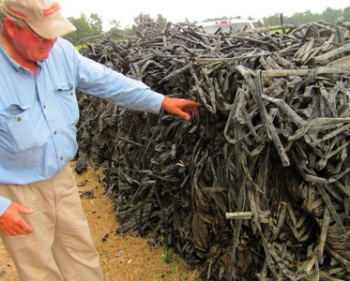
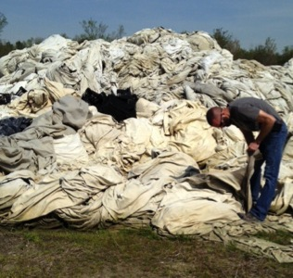
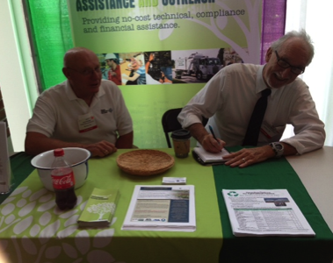
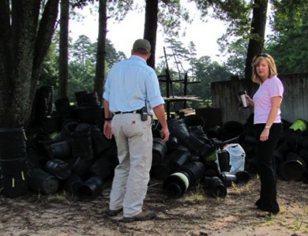
Learned about the growers needs
Emails, Phone calls, Site visits, Trade Shows

Slide 5
NC growers want to recycle more agricultural plastics
Growers hate taking their plastics to landfill
Growers want a greener image for their business
Large producers have truck load quantities and are getting on board
Growers are beginning to work together to get truck load quantities

Slide 6
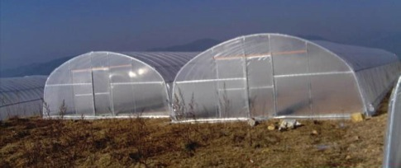
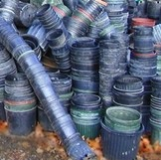
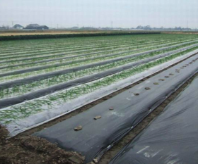
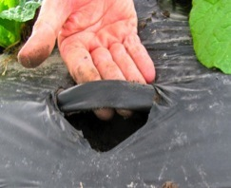
Ag Plastics – annual consumption in NC www.nass.usda.gov
Overwintering Film 500 tons each April
4ml LDPE
Pots and flats 6000 tons/year
  #2 Polyethylene
  #5 Polypropylene
  #6 Polystyrene
Black Mulch Film 2,800 tons/year
LDPE
Drip Tape 1,300 tons/year

Slide 7
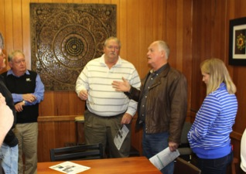
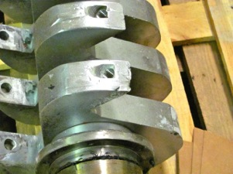
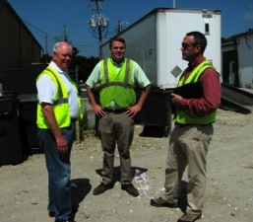
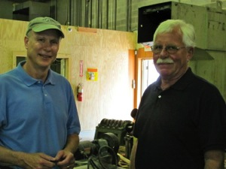
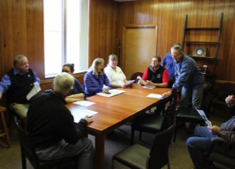
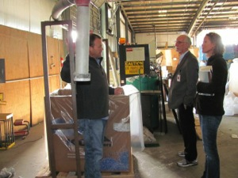
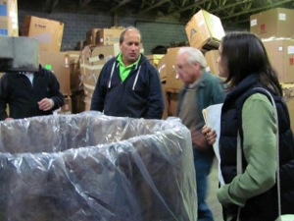
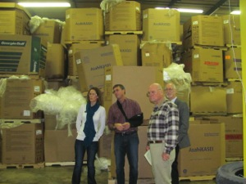
Learned from the recyclers
Emails, Phone calls, Site visits, Trade Shows

Slide 8
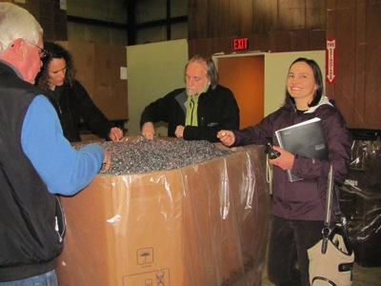
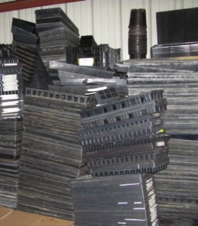
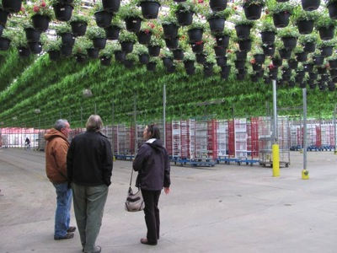
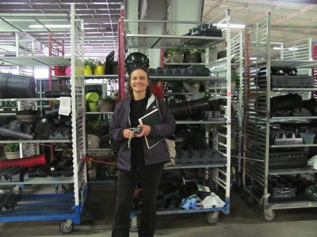
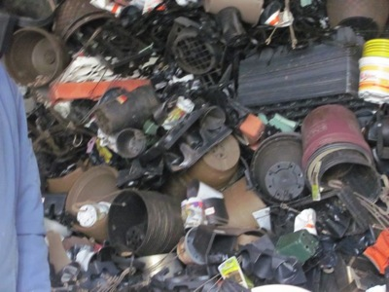
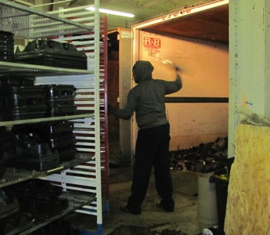
From pot back to pot is happening in NC

Slide 9
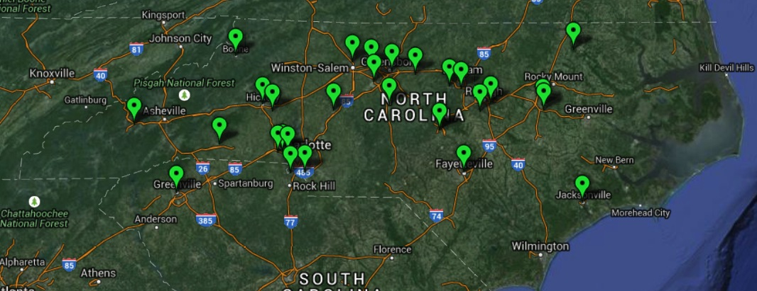
Agricultural Plastics Recyclers in NC

Slide 10
Try to recycle the easy things first
1. Team Effort
Dept. of Ag, NCNLA, DEACS, WRP
7. Tackle more difficult plastics
2. Learn
Talk with growers & recyclers
6. Outreach
Flyers, Write articles, Rack cards, Website, Facebook.
3. Tackle low hanging fruit
Large acreage grower near a recycler
5. Consolidation Sites
Growers, County Waste Facilities. Farmers Markets
4. Funding
SWMTF
NC Tobacco Trust Fund Commission

Slide 11
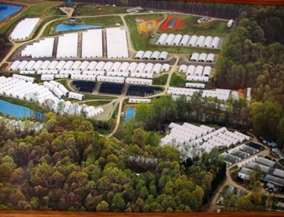
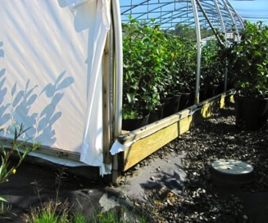
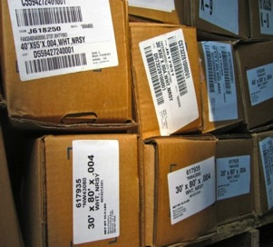
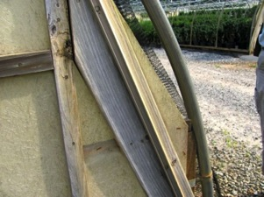
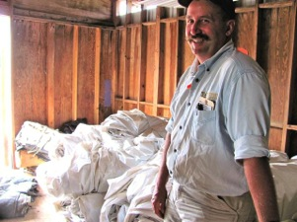
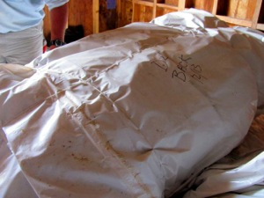
Overwintering film – success stories
Cam Too – 200 houses (100’ x40’) 150 pounds each
Put it into his own truck & drove it to the recycler – he wanted it out of the way fast
before the wind blew!
Hefner’s Nursery – 12 houses (100’ x 40’)
Stored it under cover until he was sure he did not have to put it up again, then drove
it to a nearby recycler

Slide 12
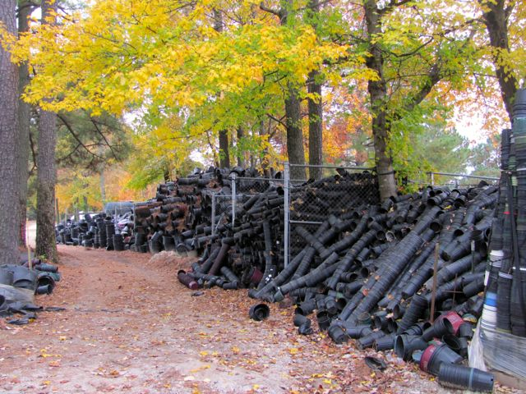
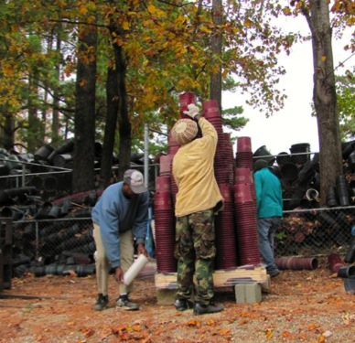
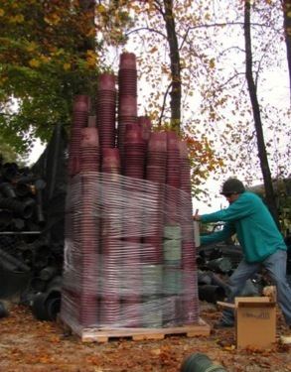
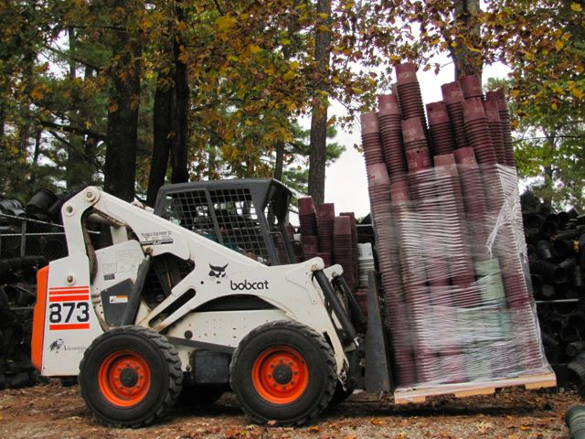
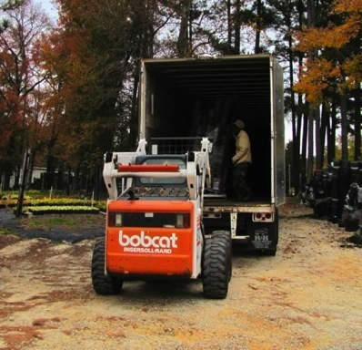
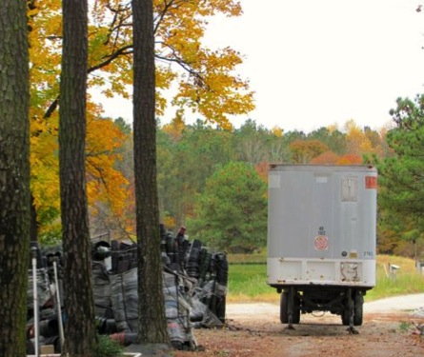
Clear out the build up over many years
25.5 tons of pots recycled, $1071 tipping fees saved

Slide 13
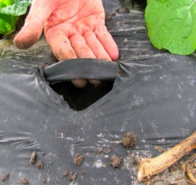
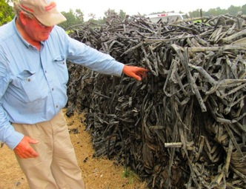
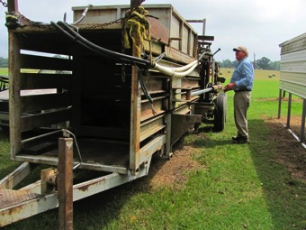
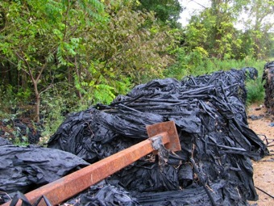
Drip Tape ~1300 tons/year
Black mulch film ~2800 tons/year
LLDPE in contact with the ground
Pulled up in the winter months
Growers prefer to pull up the film and drip tape together
These growers often have old tobacco bailers
Generally these growers do not expect payment for the material
Seems to be easier to get truck load quantities

Slide 14
Use the early success to obtain funding to set up consolidation sites and spread the word
1. Team Effort
Dept. of Ag, NCNLA, DEACS, WRP
7. Tackle more difficult plastics
2. Learn
Talk with growers & recyclers
6. Outreach
Flyers, Write articles, Rack cards, Website, Facebook.
3. Tackle low hanging fruit
Large acreage grower near a recycler
5. Consolidation Sites
Growers, County Waste Facilities. Farmers Markets
4. Funding
SWMTF
NC Tobacco Trust Fund Commission

Slide 15
Funding: NC Tobacco Trust Fund Commission
Collected data showing we could get ag plastics recycled
Put together an argument to help growers save money and also create
jobs in the recycling industry in NC
Project: Agricultural Plastics Recycling
Contact: Terry Albrecht
Waste Reduction Partners, Land of Sky Regional Council
339 New Leicester Hwy., Suite 140
Asheville, NC 28806
828-251-6622
Grant Amount: $40,000
Summary: The project will develop a pilot demonstration program that will promote the cost benefits and increased marketing potential of discarded agricultural plastics and overwintering film for recycling.

Slide 16
Consolidation sites for smaller acreage growers, the public, landscapers
1. Team Effort
Dept. of Ag, NCNLA, DEACS, WRP
7. Tackle more difficult plastics
2. Learn
Talk with growers & recyclers
6. Outreach
Flyers, Write articles, Rack cards, Website, Facebook.
3. Tackle low hanging fruit
Large acreage grower near a recycler
5. Consolidation Sites
Growers, County Waste Facilities. Farmers Markets
4. Funding
SWMTF
NC Tobacco Trust Fund Commission

Slide 17
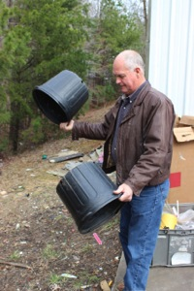
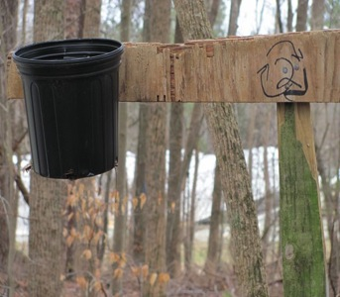
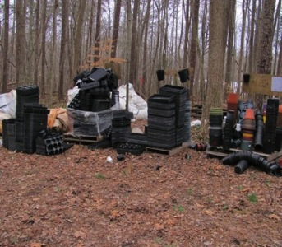
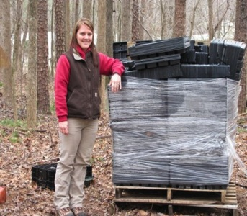
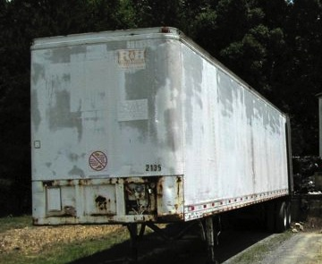
Nursery containers – Challenges
Shake Sort Stack Wrap
Full loads

Slide 18
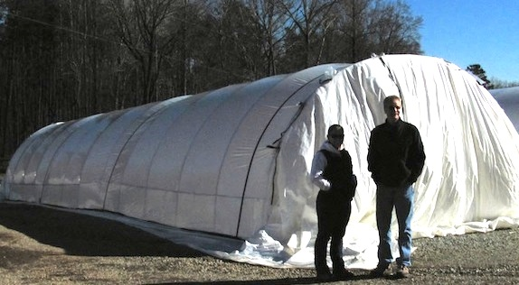
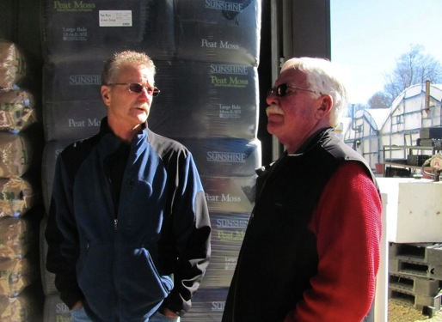




One nursery acting as a consolidation site for their customers
Sort, Stack & Wrap

Slide 19




Consolidation sites needed for smaller acreage growers

Slide 20




Johnston County Nursery Association - collection site at Panther Creek Nursery
Organized a trip to visit a recycler
Establishing a collection site for their members
First load – broke even (5.6 tons)

Slide 21



Piedmont-Triad Farmers Market, Colfax
Consolidation site for pots from public, vendors, growers, landscapers

Slide 22
County Solid Waste Facilities
Work closely with DEACS
Might have balers or equipment to help process
Introduce them to agricultural plastics recyclers
Make them aware of the volumes of ag plastics in NC
Help promote agricultural plastics recycling at their facility
Eligible for community grants to establish infrastructure

Slide 23
Make growers, landscapers, the public aware of the opportunities created to recycle age plastics
1. Team Effort
Dept. of Ag, NCNLA, DEACS, WRP
7. Tackle more difficult plastics
2. Learn
Talk with growers & recyclers
6. Outreach
Flyers, Write articles, Rack cards, Website, Facebook.
3. Tackle low hanging fruit
Large acreage grower near a recycler
5. Consolidation Sites
Growers, County Waste Facilities. Farmers Markets
4. Funding
SWMTF
NC Tobacco Trust Fund Commission

Slide 24


www.ncagplastics.org
Facebook:
North Carolina Agricultural Plastics Recycling

Slide 25


Agricultural plastics recycling flyer

Slide 26


Rack Card for Piedmont Triad Farmers Market
Can be edited for other consolidation sites

Slide 27
Now working on solutions for the harder to recycle agricultural plastics
1. Team Effort
Dept. of Ag, NCNLA, DEACS, WRP
7. Tackle more difficult plastics
2. Learn
Talk with growers & recyclers
6. Outreach
Flyers, Write articles, Rack cards, Website, Facebook.
3. Tackle low hanging fruit
Large acreage grower near a recycler
5. Consolidation Sites
Growers, County Waste Facilities. Farmers Markets
4. Funding
SWMTF
NC Tobacco Trust Fund Commission

Slide 28



More challenging agricultural plastics
Row cover
“Reemay”
Spun-bonded polyester
Non-woven polyester
Non-woven polypropylene
Mulch film
Black or white LDPE film
In contact with ground
~ 20-50% dirt
LDPE
Bankrupt nursery
Plastic woven sheeting

Slide 29


Agricultural plastics recycled
May 2012 - now
2,078 tons
$87,272
Diverted from landfills
Savings in tipping fees
+ $30,505 payment to growers from recyclers

Slide 30











WRP Current Funding Partners
NC Department of Environmental Assistance and Customer Service / NC DENR
Tobacco Trust Fund Commission
State Energy Office / NCDOC
USDA Rural Utility Service
US EPA
Cherokee Preservation Foundation
City of Asheville – Water Resources
Progress Energy Carolinas
Town of Boone
Private Contributions

Slide 31
Contact Details
Bev Fermor
Waste Reduction Partners
Phone/Text: 919-597-0698
Email: bfermor@tjcog.org
Web: ncagplastics.org

