Slide 1
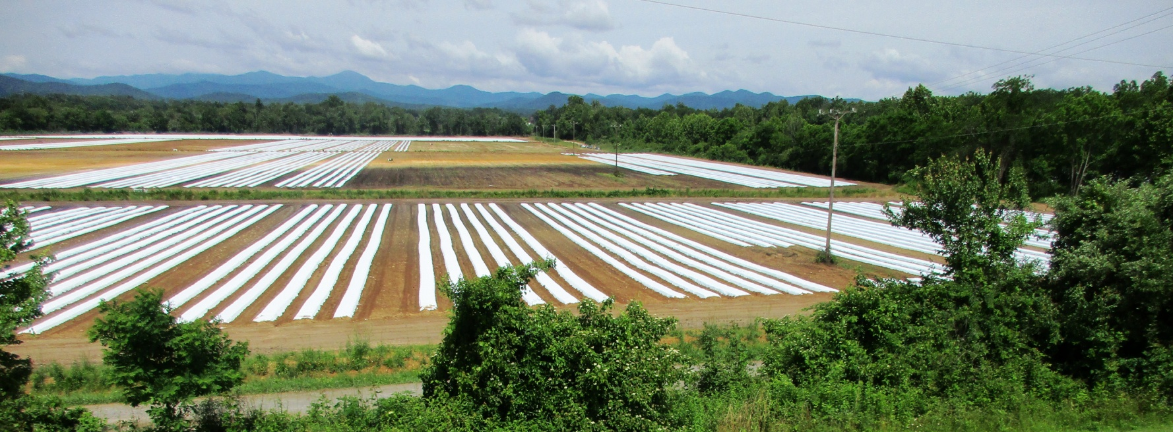



NC Agricultural Mulch Film Recycling Project
Progress Report May 2018

Slide 2
Obstacles to Recycling Ag Mulch Films
Film is dirty with plant material / soil
Insufficient quantities from one source
No connection between farm and reprocessor
Farmer and reprocessors speak different languages
Farmers said “I would like to recycle, but It is simpler to pay landfill / transfer station charges”

Slide 3
Overall Project Goals
To reduce cost for the farmers
To achieve an acceptable level of film cleanliness
To facilitate a connection between farmer and reprocessor (Permanent middle man?)
To make recycling the preferred method

Slide 4
Goals of the Project on the Farm
  To require less manpower (reduce costs)
  To remove as much dirt as possible
  To achieve a tighter, more manageable bundle
  To achieve a reasonable ROI for the farmer
  Develop a set standard procedures

Slide 5
Farm Mulch/Tape Retrieval Methods
WRP Ag Mulch Team has identified four basic retrieval methods:
  Manual methods (Armstrong technique)
  Slit and Wind S/W (Machine travels row, winds from side of the plants)
  Roll the Row RTR (Machine travels along the row)
  End of the Row EOR (Wind-up machine pulls the film to the end or middle of the row)
  In all methods, tape and film should be collected separately

Slide 6

Removal of Vegetation, All Methods
Use a flail mower or bed mower with roller
  Cleaner removal of vegetation
  Small debris pieces
  Must be properly adjusted
  Roller positions blades
Farmers typically use a “Bushog” to chop the crop
  Hard to control, may chop the film

Slide 7
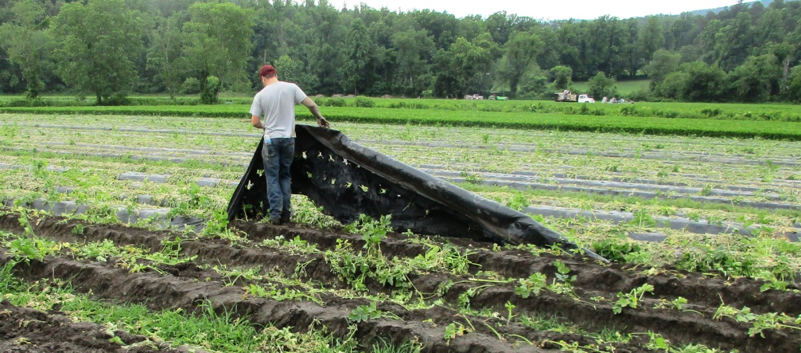
Mulch Retrieving Methods
Armstrong Method
  Many farm hands who tear film from ground
  Gather by hand
  Costly ($200+/ acre)
  Time consuming
Results In
  Loose dirty bundles
  Generally mulch and drip tape mixed
  Not acceptable by recyclers

Slide 8
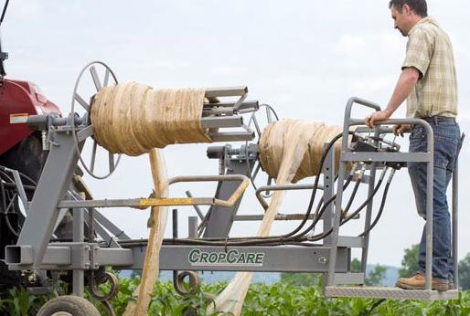
Ride the Row, Slit and Wind
RTR unit slits, lifts and winds from the soil in one pass.
  Tension control is manual / hydraulic
  Bundles can be handled by one person
  Only a two-person team

Slide 9
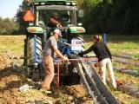
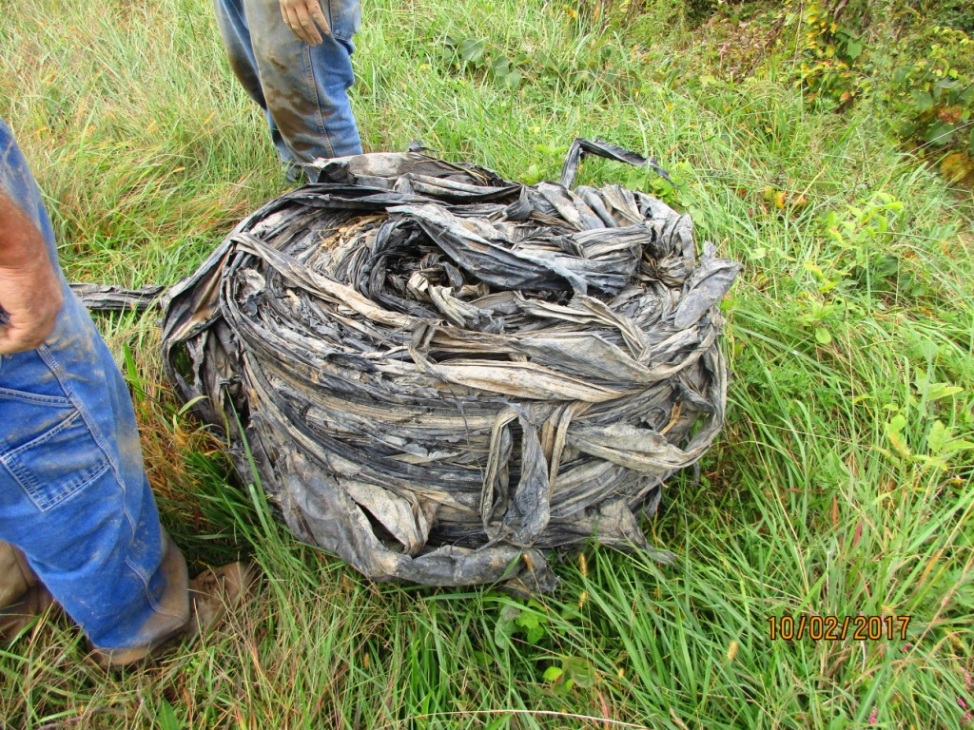
End of Row Concept
Pull the film over bumpy rollers to loosen and lose the soil and debris, then drop film in back on the ground
In another pass, wind the film up into 200+ pound rolls from the end or middle of row

Slide 10
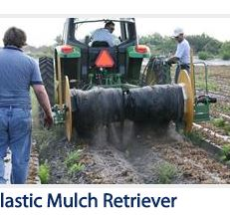
Roll the Row
Film is rolled into one large roll
Much vegetation is trapped within roll

Slide 11
Methods of 2017 Trials
Using Industrial Engineering time study methods to measure:
  Field size and row length
  Time to complete retrieval operations
  Manhours and labor costs
  Depreciation cost of equipment
  Applied farm overhead and related costs
Developed cost/acre for each method

Slide 12
Comparison of Cost to Retrieve Mulch
Method | Manual | End of Row | Slit/ Wind
Mowing | Not done | $17.65 | $14.93
Lifting film |  | $39.23 | $43.97
Winding the film |  | $5.45 | included
Retrieving drip tape |  | $14.53 | $12.30
Total $/Acre | $238.00 | $76.86 | $71.19

Slide 13
2017 Summary Results
Crop must be mowed
  Wait several days after mowing (dry out)
Balers are not a good fit with NC farms
Crew size can be as low as two
Roll the Row traps too much vegetation
S/W and End of Row result in similar cost savings, about $125.00+ / acre

Slide 14
Farm Disposal Economics
Assuming 5 tons = 20 acres of mulch, 40 mile trip to landfill / transfer center
            Cost
Truck operating cost $ 68.00
Crew costs $120.00
Tipping fees $300.00
Total cost $488.00
  Cost $/ acre $24.40

Slide 15
Unanswered Questions?
What/who should be the intermediary from farm to Reprocessor?
Is this a business opportunity?

Slide 16
2018 Field Trial Plans
Buy retrieval equipment for test fleet
Make improvements to equipment
Create "Best Management Bulletins"
  NC Ag Extension Service
Trial on other crops and farms
Promote at farm conference & venues

Slide 17
Our Partners on the Farm
Andros Engineering
Kennco Manufacturing, Inc.
CropCare Equipment
North River Farms
Flavor1st Growers
Sierra Nevada Brewing Co

Slide 18
More information?
Contact Waste Reduction Partners:
dlowles@wrpnc.org
Check us out at:
www.wastereductionpartners.org

